Slide 1
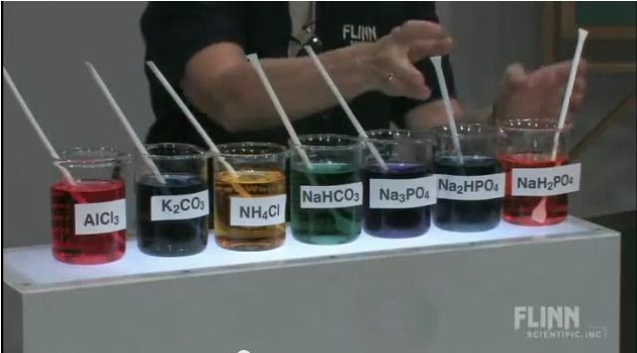
Acid-base chemistry
Salts and water
ATAR Chemistry Unit 3 2021

Slide 2
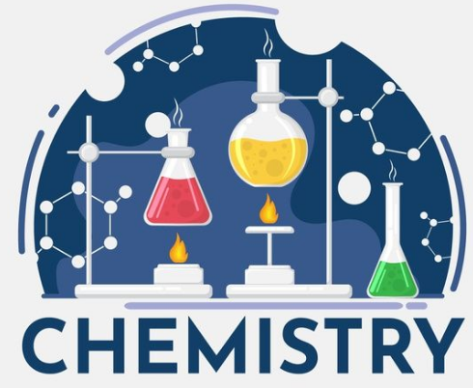
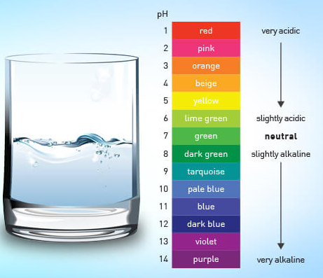
Outline
Acid-base properties of salts
Autoionisation of water and Kw
Acidity and pH

Slide 3
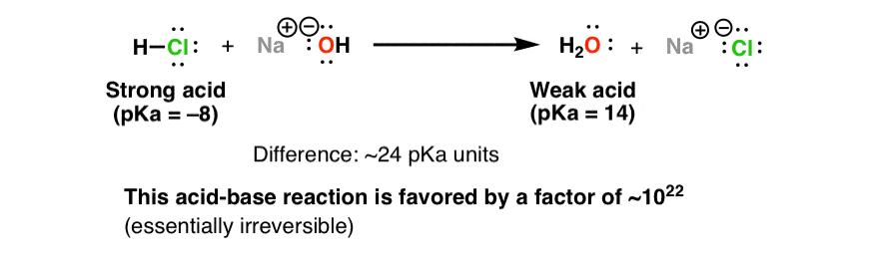
Acid-base properties of salt
In neutralisation reactions an acid and base react to give salt plus water
Strong acid + strong base
Recall – the stronger the acid, the weaker its conjugate base. Chloride ions are so weak they are considered neutral

Slide 4
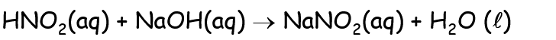
Acid-base properties of salt
Consider what happens when we have a weak acid with a strong base
Weak acid + strong base
Weak acid
Strong base
Strong conjugate base
Weak conjugate acid
If I take solid sodium nitrite (NaNO₂) and add it to water?
NO₂⁻_{(aq)} + H₂O_{(l)} HNO_{2(aq)} + OH⁻_{(aq)}
Proton acceptor
Formation of OH⁻ makes the solution basic

Slide 5
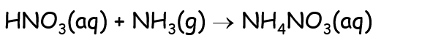
Acid-base properties of salt
Consider what happens when we have a strong acid with a weak base
Strong acid + weak base
HNO_{3(aq)} + NH_{3(g)} NH₄⁺_{(aq)} + NO₃⁻_{(aq)}
Strong acid
Weak base
Strong conjugate acid
Very weak conjugate base
If I put ammonium (NH₄⁺) in water?
NH₄⁺_{(aq)} + H₂O_{(l)} H₃O⁺_{(aq)} + NH_{3(aq)}
Proton donor
Formation of H₃O⁺ makes the solution acidic

Slide 6
Acid-base properties of salt
Salts can be neutral, acidic or basic when we dissolve them in water
If one of the ions present reacts with water to form hydronium ions (H₃O⁺) then the solution becomes acidic
If one of the ions present reacts with water to form hydroxide ions (OH⁻) then the solution becomes basic
The reaction of a salt with water is called hydrolysis
Some salts contain ions that are acidic and basic, it then depends on which in the stronger acid or base

Slide 7
Acid-base properties of salt
 | Strong base | Weak base
Strong acid | Neutral salt | Acidic salt
Weak acid | Basic salt | Neutral salt

Slide 8
Acid-base properties of salt
** Misconception alert **
The misconception – weak acids are strong bases
The truth – this is not correct, for example methane (CH₄) is a weak acid but it cannot act as a base as it does not have a lone pair of electrons.
The correct phrase – weak acids have strong conjugate bases, eg the conjugate base of methane is CH₃⁻ which is an extremely strong base.

Slide 9
Autoionisation of water
A very small amount of water undergoes autoionisation (splits into ions on its own)
The equilibrium strongly favours molecular water, H₂O
In pure water [H⁺] = [OH⁻] = 1.0 x 10⁻⁷ mol L⁻¹ at 25 °C
When the concentrations of hydronium and hydroxide are equal the solution is neutral

Slide 10
Autoionisation of water
Consider the equilibrium:
what happens to the concentration of hydronium if I add an acid?
What happens to the concentration if I add a base?
I not only increase [H₃O⁺], but the imposed change also shifts the equilibrium to reduce [OH⁻]
I not only increase [OH⁻] but the imposed change also shifts the equilibrium to reduce [H₃O⁺]

Slide 11


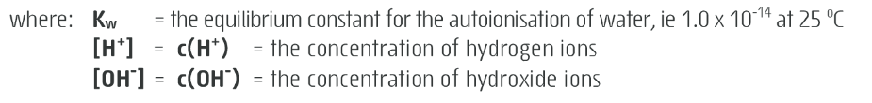
Autoionisation of water
Write the equilibrium expression for the above equilibrium

Slide 12

Autoionisation of water
Write the equilibrium expression for the above equilibrium

Slide 13
Autoionisation of water
[H+] and [OH-] are inversely proportional (if one goes up the other goes down)
If [H+] increases by a factor of 3 then [OH-] decreases by a factor of 3
The extremely small value of Kw means the equilibrium strongly favours molecular water
Kw changes with temperature, higher temperature favour the formation of products (as the forward reaction is endothermic)

Slide 14
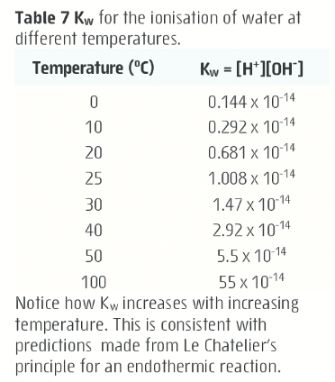
Autoionisation of water
At a given temperature we know the value of Kw so we can use this to calculate the concentration of H⁺ if we know the concentration of OH⁻ and vice versa

Slide 15
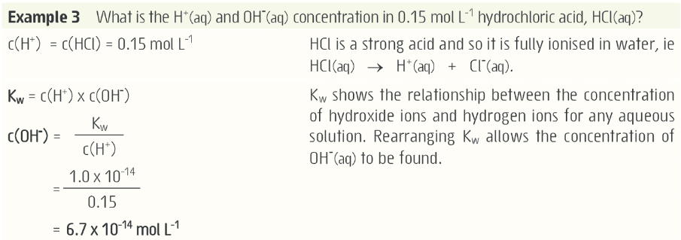
Autoionisation of water

Slide 16
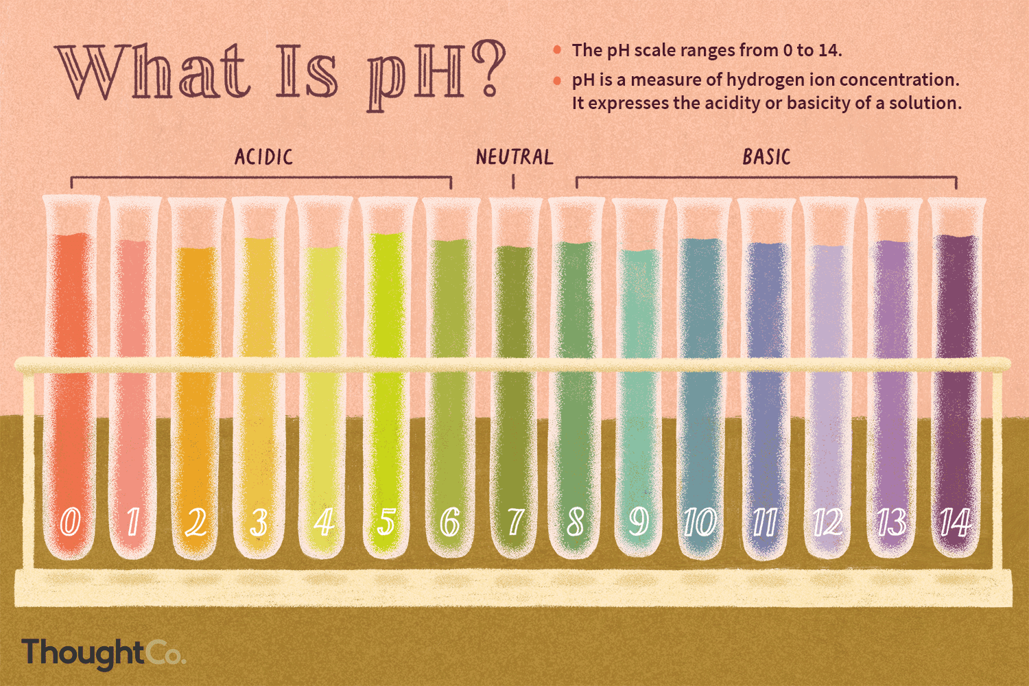
Acidity and pH

Slide 17
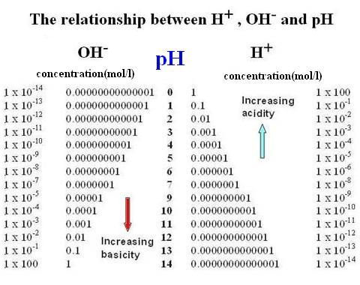
Acidity and pH
Acidity depends on the H⁺ concentration
A convenient way to display this is using the pH scale
The pH scale is logarithmic

Slide 18
Acidity and pH
pH = - log [H⁺]
If given the pH you can calculate [H⁺] and by using Kw then [OH⁻]
If you are given [H⁺] or [OH⁻] you can use Kw and calculate pH

Slide 19
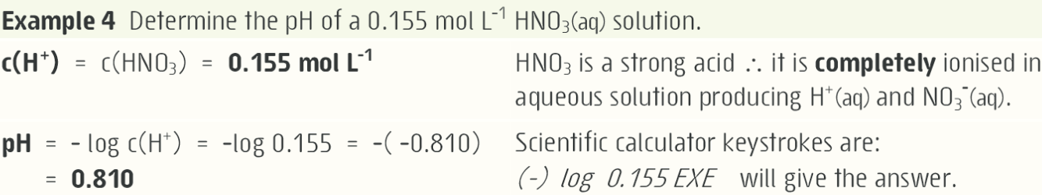
Acidity and pH
pH = - log [H⁺]

Slide 20
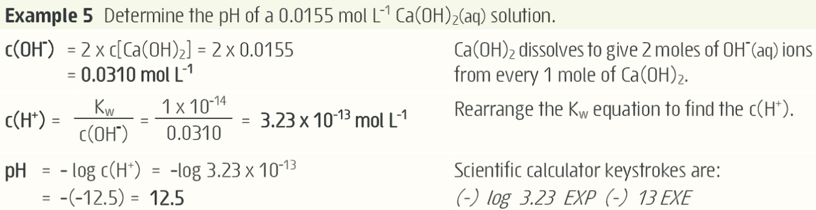
Acidity and pH
pH = - log [H⁺]

Slide 21
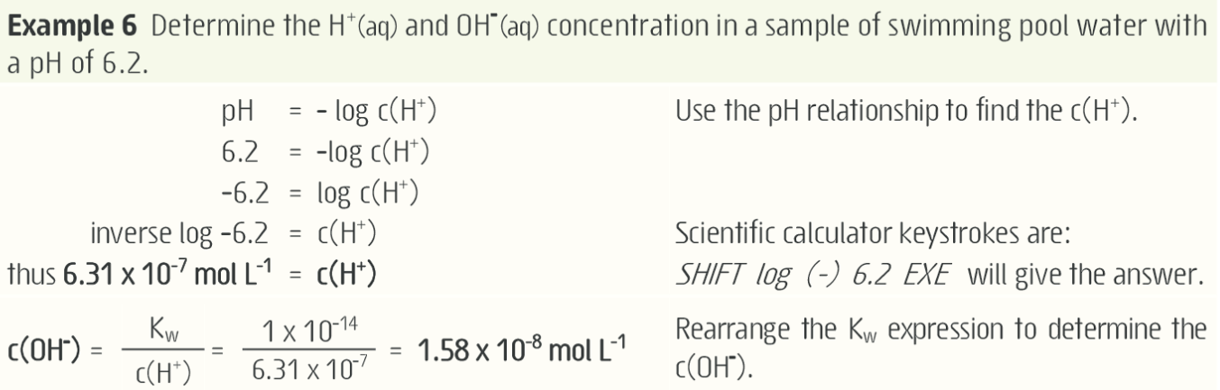
Acidity and pH
pH = - log [H⁺]

Slide 22






Stoichiometry
Concentration
$$c= \frac{n}{V}$$
$$c= \frac{n}{V}$$
Balanced
Equation
$$n= \frac{m}{M}$$
$$n= \frac{m}{M}$$
Reactant
Moles
Product
Moles
Mass
$$Vstp= \frac{n}{22.71}$$
$$Vstp= \frac{n}{22.71}$$
volume
volume

Slide 23
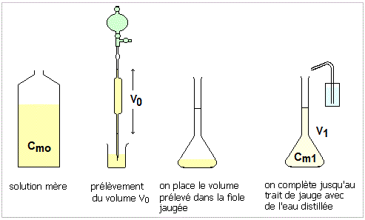
Dilution
Step 1: Starting solution Concentration before = c_{before}
Step 2: Take an aliquot
volume before = V_{before}
V_{before}
Step 3: Put the aliquot in a new flask and add extra water to it
V_{after}
C_{before}
C_{after}
Step 4: Concentration after = c_{after}
Volume after = V_{after}
C_{before} x V_{before} = C_{after} x V_{after}

